Slide 1
Next month September: Sept 8th at 6:38 am

Slide 2
Next month September: Sept 8th at 6:38 am

Slide 3

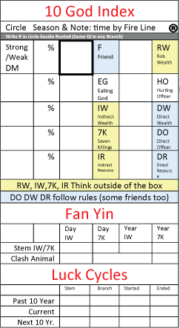
10 Gods Calculation
Date of birth: November 5 1963
Gua # 1
Day Master: Ren Zi
Structure (profile): 7K & RW
Occupation:
Chart
Ren
Jia
Bing
Wu
Geng
Gui
Yi
Ding
Ji
Xin
Start with day master
Bing

Slide 4
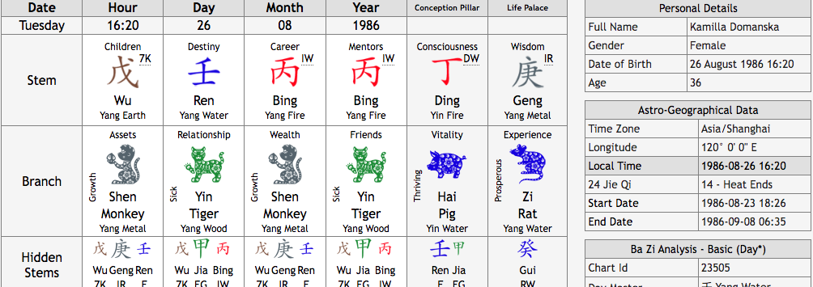
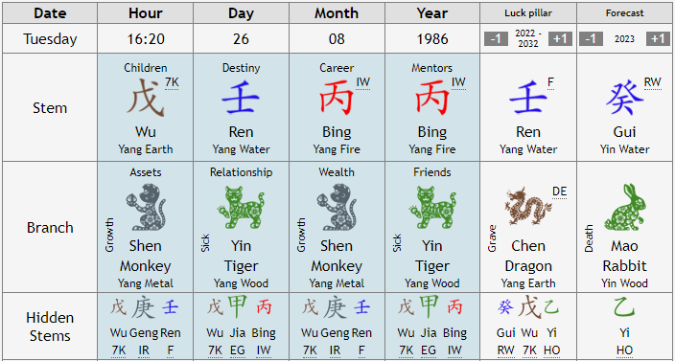
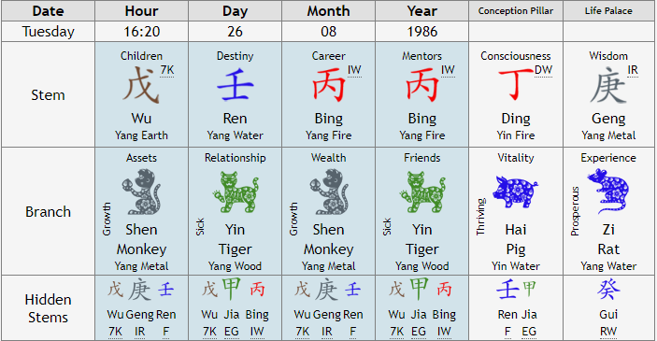
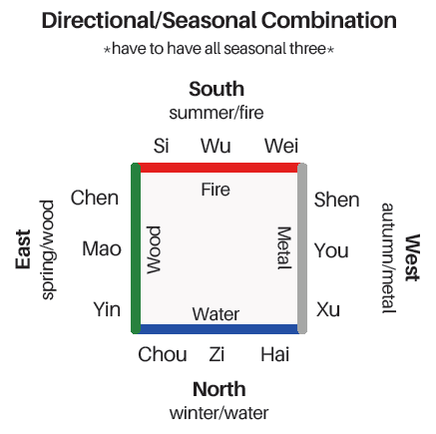

Slide 5
